Slide 1
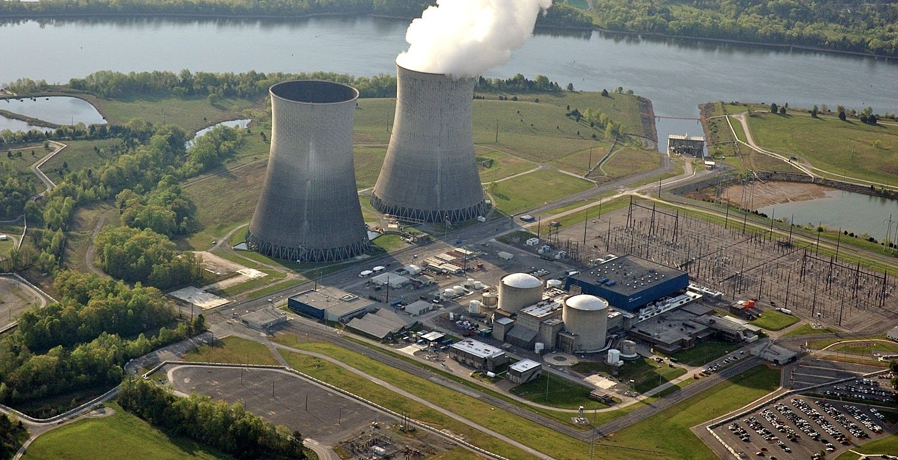
Nuclear Science Merit Badge:
Nuclear Power Technology
Notes:
http://fresnobeehive.com/news/Nuclear%20plant.JPG

Slide 2
Introduction!
Welcome to {INSERT SITE NAME}
Nuclear Power and Technology
Information for the course was taken from the Nuclear Science Merit Badge Handbook.

Slide 3
Learning Objectives
History of fission
Nuclear power
Types of reactors
Reactor safety
Fusion

Slide 4
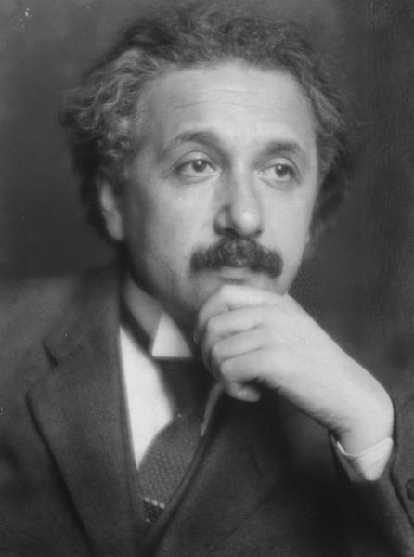
Albert Einstein
“Any intelligent fool can make things bigger and more complex... It takes a touch of genius - and a lot of courage to move in the opposite direction.”

Slide 5
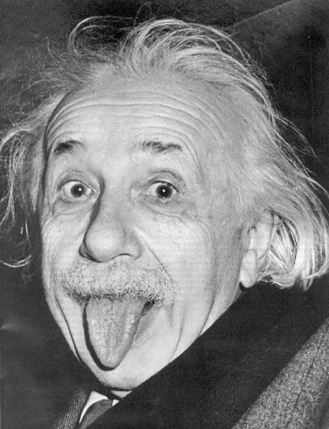
Nuclear Energy
E = mc²
c²=89875517873681764 m/s
or 6701 million mph
Photoelectric effect
Mass Defect
Social Recognition
Nuclear energy is the energy produced when an atom is split or fused.
Very high energy density
Notes:
http://en.wikipedia.org/wiki/File:Albert_Einstein_portrait.jpg
Mass defect: sum of the parts is not equal to mass of the new nucleus. Some mass is lost in the energy required to bind them together.
Photoelectric effect: defined light as photons, not waves. Energy=frequency*plank’s constant

Slide 6
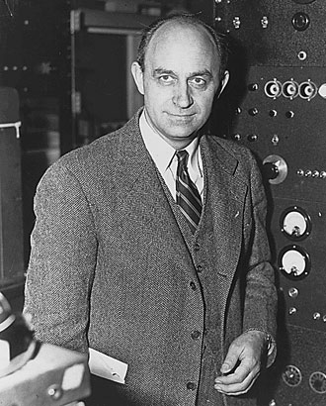
Enrico Fermi
“There are two possible outcomes: if the result confirms the hypothesis, then you've made a measurement. If the result is contrary to the hypothesis, then you've made a discovery.”

Slide 7
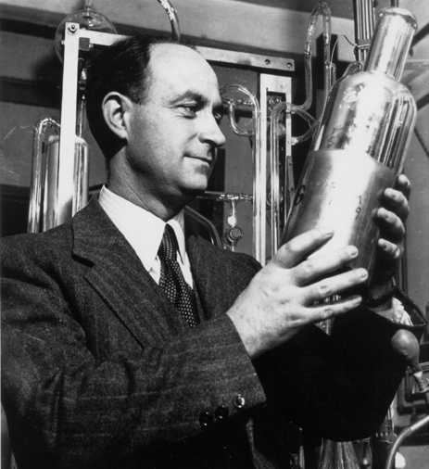
The Power of the Neutron
Fission
Firing a neutron at a nucleus
has 2 outcomes.
1. Creates a new isotope of the same element.
2. The neutron breaks down into a beta particle (electron) and a proton, causing the atom to become the next higher element.
http://www-news.uchicago.edu/fermi/enrico4.jpg

Slide 8
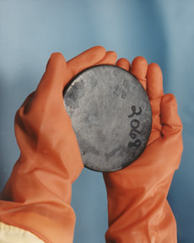
Uranium-235: The Special Case
What happened when a uranium-235 nucleus was struck by a neutron?
Instead of finding element number 93, an atom with mass of barium, element number 56 was found.
Otto Hahn, Lise Meitner, Fritz Strassmann and Otto Frisch concluded that the atom actually split and the process was called “fission”.

Slide 9
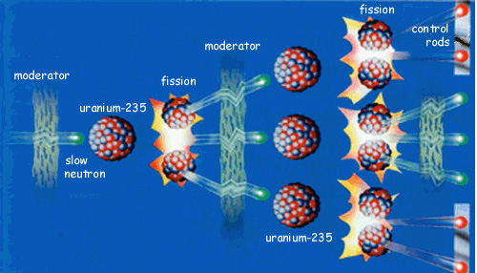
Chain Reaction
Fission produces two daughter atoms (called fission fragments), neutrons, and lots of ENERGY
Since neutrons are products of fission, they can be used to “fission” other atoms, creating a chain of continuous fissions.
Moderators: slower neutrons are more likely to cause fission than faster neutrons

Slide 10
Chain Reaction

Slide 11
Demo Chain Reaction
Use dominoes to model a chain reaction.
Neutron hits a nucleus
Creates more neutrons , some of which hit another nucleus and cause another reaction, some of which leak off.

Slide 12
A chain reaction in detail

Slide 13
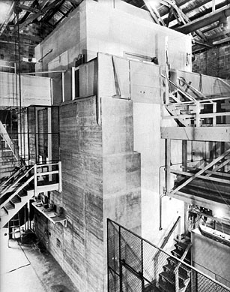
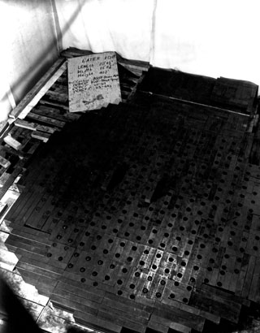
The First Nuclear Reactor
In 1942, the first atomic pile was built by Fermi and a group of scientists by carefully spacing lumps of uranium in graphite (the moderator).
Rods covered with cadmium, called “control rods,” were used to keep the reaction from starting by absorbing neutrons.
As the rods were removed, the neutrons started the chain reaction and the pile became “critical”
Notes:
Called Chicago Pile1
Moderator- slows neutrons down because slow neutrons are more likely to cause a reaction.

Slide 14
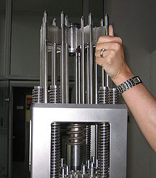
The First Nuclear Reactor
They had created the world’s first nuclear reactor (December 2, 1942).
A nuclear reactor is a device in which a self-sustained nuclear fission chain reaction can be maintained and controlled.
The reaction can be stopped by inserting the control rods to absorb the neutrons.

Slide 15
Make a Drawing of the Nuclear Fission Process (5 minutes)
1. A neutron hits a uranium nucleus.
(No, you don’t have to draw every proton and neutron)
2. The nucleus stretches and bends
3. The nucleus breaks apart, releasing two smaller parts called fission fragments, along with neutrons and lots of energy.

Slide 16
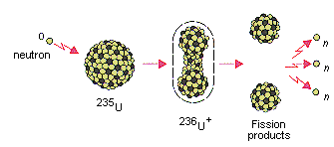
Drawing of the Nuclear Fission Process

Slide 17
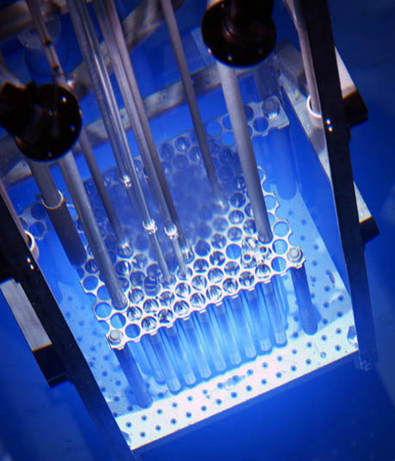
Show How To Start and Stop a Chain Reaction (5 minutes)
How can a chain reaction be started and stopped in a critical mass?
A critical mass is an amount of nuclear fuel required to sustain a chain reaction.
1. Remove control rods
2. Bombard mass with neutrons
3. Insert control rods

Slide 18
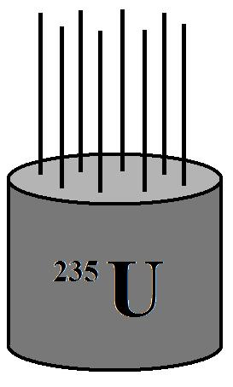
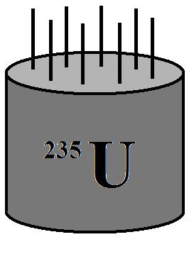
3.
Starting and Stopping a Chain Reaction
2.
1.

Slide 19
Typical Reactor Design

Slide 20
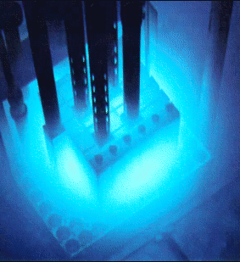
Recap of Important Reactor Terms
Moderator- the substance used to slow down the neutrons.
Control Rods- used to control the reaction by absorbing neutrons.
Fission Products- two daughter atoms, neutrons, and lots of energy
Notes:
Moderator-slow neutrons are more likely to cause a reaction
Control rods- no neutrons, no reaction: they stop the chain reaction

Slide 21
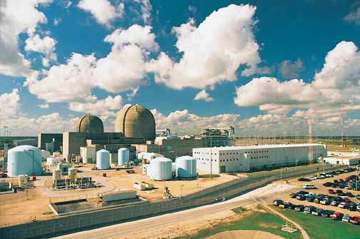
Nuclear Energy
Notes:
http://honors.tamu.edu/honors/community/ship/students/nuclear_science.jpg
http://www.stpegs.com/About.htm

Slide 22
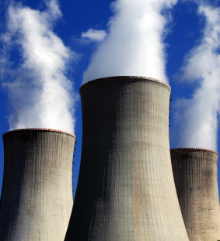
Nuclear Energy – Quick facts
Percent of total electricity production
US - 20%
World - 18%
Number of plants
US - 104
World - 437
Average electrical output of a plant
US - 968 MW
World - 850 MW
Notes:
Following a 30-year period in which few new reactors were built, it is expected that 4-6 new units may come on line by 2018, the first of those resulting from 16 licence applications to build 24 new nuclear reactors made since mid-2007.
Government policy changes since the late 1990s have helped pave the way for significant growth in nuclear capacity. Government and industry are working closely on expedited approval for construction and new plant designs.
Despite a near halt in new construction of more than 30 years, US reliance on nuclear power has continued to grow. In 1980, nuclear plants produced 251 billion kWh, accounting for 11% of the country's electricity generation. In 2008, that output had risen to 809 billion kWh and nearly 20% of electricity, providing more than 30% of the electricity generated from nuclear power worldwide. Much of the increase came from the 47 reactors, all approved for construction before 1977, that came on line in the late 1970s and 1980s, more than doubling US nuclear generation capacity. The US nuclear industry has also achieved remarkable gains in power plant utilisation through improved refuelling, maintenance and safety systems at existing plants.
http://www.world-nuclear.org/info/inf41.html

Slide 23
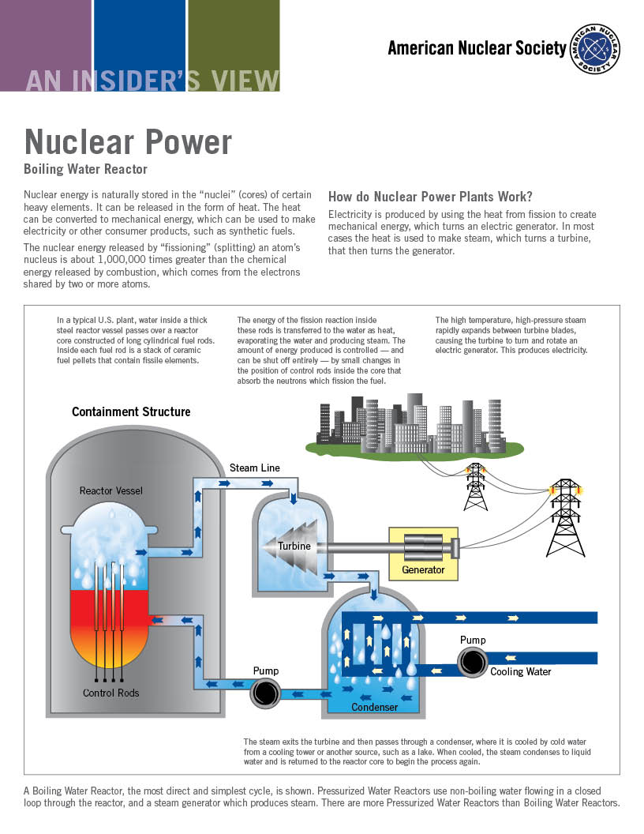
Modern Nuclear Reactors
Pressurized Water Reactors (PWRs)
Boiling Water Reactors (BWRs)
Light water and heavy water reactors
Moderators
Coolants
Notes:
http://www.tva.gov/power/images/wbndiag.gif
The light water reactor or LWR is a type of thermal reactor that uses normal water as its coolant and neutron moderator. Thermal reactors are the most common type of nuclear reactor, and light water reactors are the most common type of thermal reactor. There are three varieties of light water reactors: the pressurized water reactor (PWR), the boiling water reactor (BWR), and the supercritical water reactor (SWR).
Heavy water reactors use heavy water as a neutron moderator. Heavy water is deuterium oxide, D₂O. The most common pressurised heavy water reactor is the CANDU reactor.
http://en.wikipedia.org/wiki/Heavy_water_reactor

Slide 24
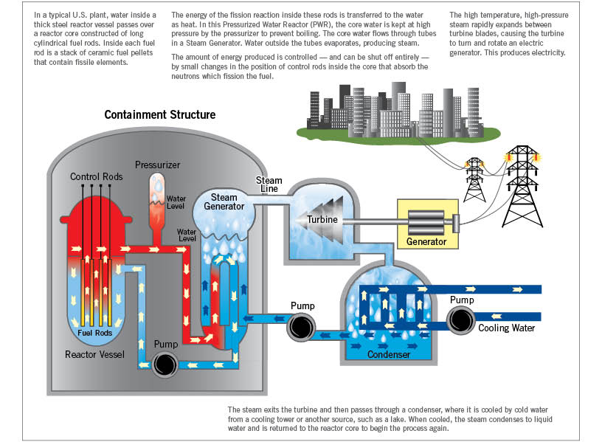
PWR (Pressurized Water Reactor)
Three main loops
High pressure, high temperature
Steam generators
Notes:
153 atm of pressure to keep water from boiling

Slide 25
BWR (Boiling Water Reactor)
Two loops
Lower Pressure, high temperature
Shielded turbine housing
Notes:
Pressure inside vessel 75 atm

Slide 26
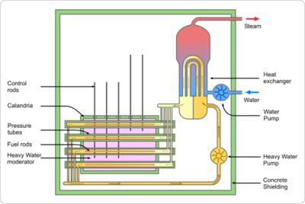
CANDU (CANadian Deuterium Uranium reactor)
Heavy water moderator
Natural uranium fuel
Three loops
Notes:
Used by India to produce enriched plutonium for a weapons program

Slide 27
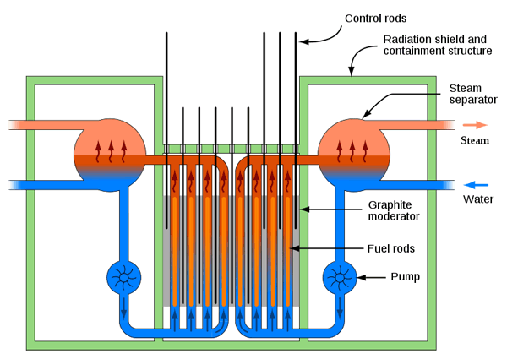
RBMK (Реактор Большой Мощности Канальный)
High powered channel type reactor
Graphite moderated
Natural uranium fuel
Safety problems
Positive void coefficient
18 sec SCRAM time
No containment
Notes:
Four seconds for a BWR or PWR to scram
In nuclear engineering, the void coefficient (more properly called "void coefficient of reactivity") is a number that can be used to estimate how much the reactivity of a nuclear reactor changes as voids (typically steam bubbles) form in the reactor moderator or coolant. Reactivity is directly related to the tendency of the reactor core to change power level: if reactivity is positive, the core power tends to increase; if it is negative, the core power tends to decrease; if reactivity is zero, the core power tends to remain stable.
http://en.wikipedia.org/wiki/Void_coefficient
A scram or SCRAM is an emergency shutdown of a nuclear reactor – though the term has been extended to cover shutdowns of other complex operations, such as server farms and even large model railroads (see Tech Model Railroad Club). In commercial reactor operations, this emergency shutdown is often referred to as a "SCRAM" at boiling water reactors (BWR), and as a "reactor trip" at pressurized water reactors (PWR).^{[a]}
http://en.wikipedia.org/wiki/Scram

Slide 28
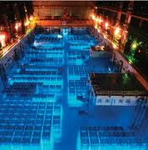
Radiation Risks from Nuclear Power
Controlled nuclear power does not pose significant radiation risks.
In transportation, used fuel is protected in casks.
In storage, used fuel is kept in cooling pools (spent fuel pools) where the radioactivity can decay and is then transferred to
dry cask storage.
Notes:
Actually be exposed to more radiation by living outside a coal plant than outside a nuclear plant. Also, will receive more radiation from flying between the east and west coast than from living outside a nuclear power plant.

Slide 29
Radiation Hazards to the Environment
Permanent Storage
US has no permanent storage plan (!)
Other countries (France, Japan) have safe, permanent storage plans and reprocess used fuel
Requirements for permanent storage
Must not seep into water supply or remain in soil and affect crops.
Concentration in carnivores due to diet.
Contamination happens when radioactive material is deposited on skin, clothing, or any place in the environment where it should not be.

Slide 30
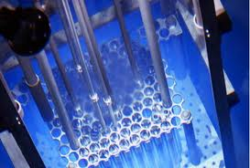
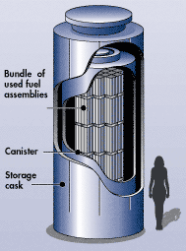
Spent Fuel Containment
Spent fuel rods from nuclear reactors pose serious health hazards if not controlled and shielded.
Special casks are designed to contain spent fuel during transportation to a safe storage
So, what if there’s an accident in-transport?

Slide 31
So, what happens if we…
Burn it!
http://www.youtube.com/watch?v=1eJMY9MT4a8
Smash it!
http://www.youtube.com/watch?v=1eJMY9MT4a8
Smash it FASTER!
http://www.youtube.com/watch?v=--_RGM4Abv8

Slide 32
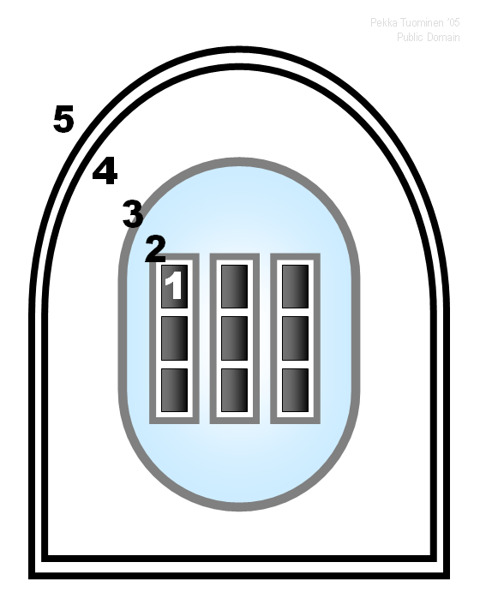
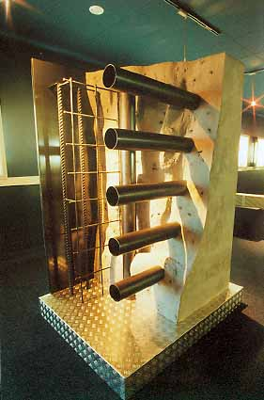
Reactor Safety
Levels of Safety
Automated emergency cooling systems
Containment
Space
Containment Wall
Notes:
Conatinment wall ~3 meters?

Slide 33
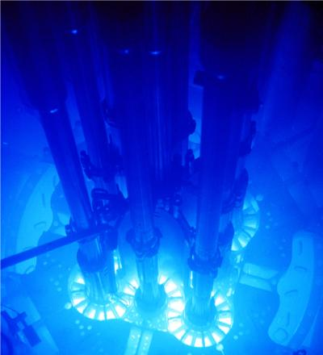
Other Purposes of Reactors
Research reactors
Production of medical radionuclides
Production of cobalt-60
Power naval vessels
Notes:
Main uses for 60Co:
As a tracer for cobalt in chemical reactions,
Sterilization of medical equipment,
Radiation source for medical radiotherapy,
Radiation source for industrial radiography,
Radioactive source for leveling devices and thickness gauges,
As a radioactive source for food irradiation and blood irradiation, and
As a radioactive source for laboratory use.

Slide 34
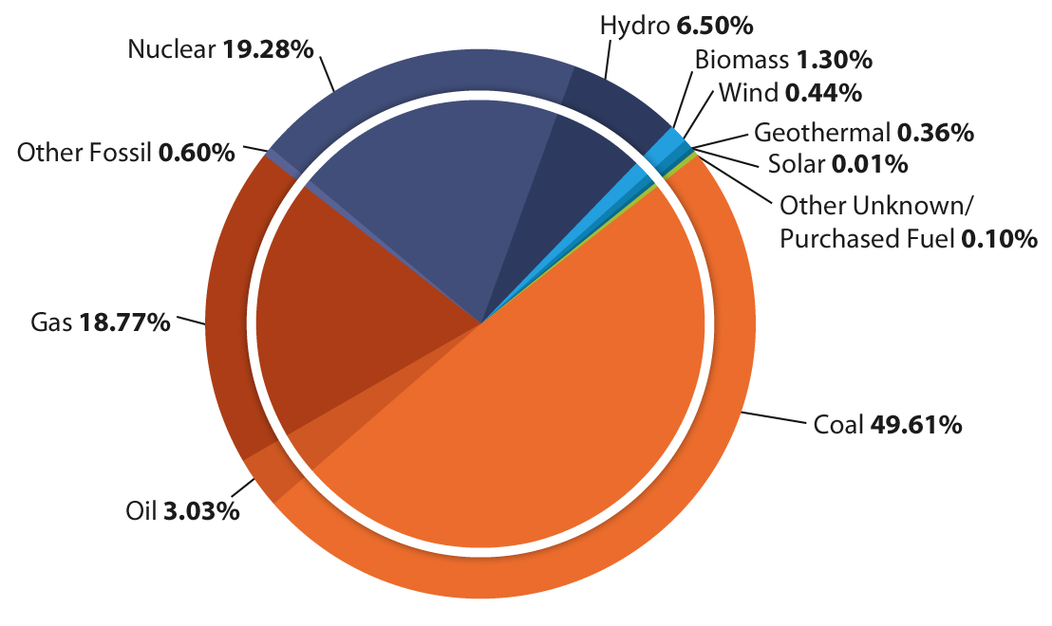
Nuclear Power in the USA
Currently there are 104 nuclear power reactors in the USA.
Applications being submitted for expansions and new reactors, but it is a long process!
Glen Rose, TX: Comanche Peak
Bay City, TX: South Texas Project
College Station: TAMU Nuclear Science Center
Notes:
http://en.wikipedia.org/wiki/File:Sources_of_electricity_in_the_USA_2006.png

Slide 35
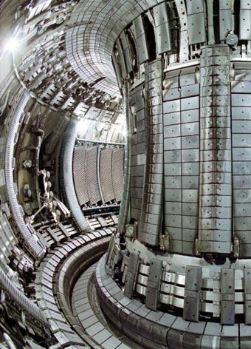
Nuclear Fusion
Instead of splitting atoms, fusion combines two atoms to make one larger atom.
This is how energy is produced in the sun.
Current plans for fusion plant called ITER
Holds plasma in place with magnetic fields.
Notes:
ITER in South France

Slide 36
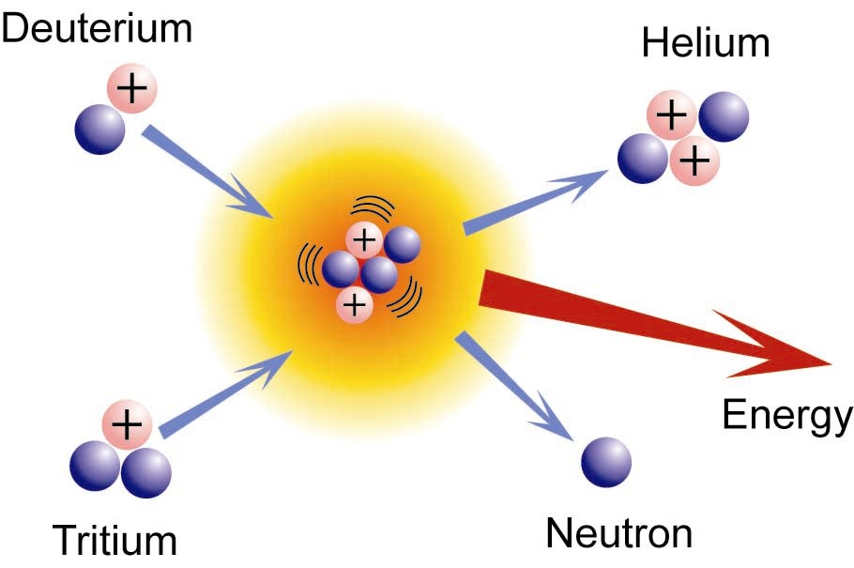
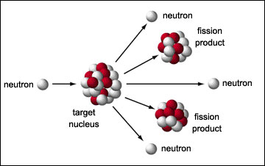
Model Fusion and Fission
Volunteers:
Fusion:
Start with two small nucleuses
End with one nucleus, energy, and neutrons.
Fission:
Start with one neutron, one nucleus.
End with two nucleuses, neutrons and energy

Slide 37
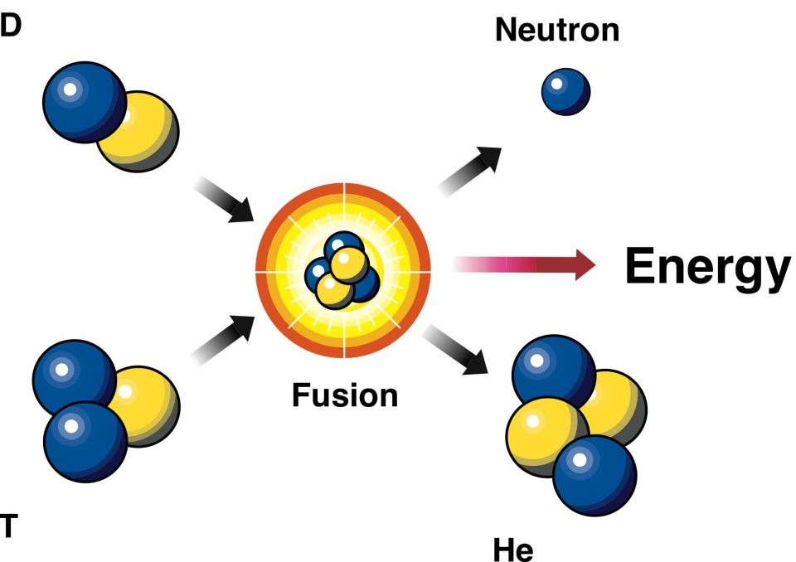
Fusion
Pros
Cons
Infinite supply of fuel
Much greater energy release per AMU than fission (~4 times as much)
Much “cleaner” than fission
Zero-emissions
Has not been demonstrated to reach “break even” energy point

Slide 38
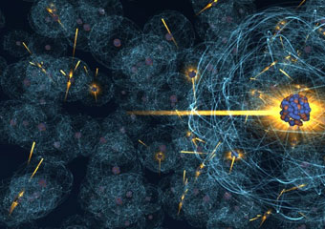
Nuclear Power Conclusion
Variety of uses:
Energy density
Environment friendly
Reliable source of energy
Challenges:
Public acceptance
Disposal of wastes
Non-proliferation
The potential of fusion power is as great as its challenges

