Slide 1
Nuclear Science Basics
Prerequisite Material for the
Nuclear Science Merit Badge Program

Slide 2
Nuclear Science Basics
Prerequisite Material for the
Nuclear Merit Badge Program

Slide 3
Introduction
Thank you for choosing to be a part of our merit badge program.
This slideshow is to teach you or review for you the basics of chemistry, radiation, and some basic terms.
There will be a slide with information, and then a slide with graphics to help explain the concepts.
You should go through this presentation by yourself, only seeking outside help if you really need assistance.
If you do need further assistance, you can E-mail one of our counselors at this address:
{INSERT YOUR CONTACT INFORMATION}

Slide 4
Our Universe
Everything in the universe is made of matter.
Examples:
You
Trees
Automobiles
The sky
The computer you are staring at now
At its smallest level, matter is composed of atoms.

Slide 5
Atoms
Atoms are the basic building blocks of all matter. An entire section of science, Chemistry, is devoted to studying in detail how atoms interact with each other.
Atoms can interact by moving past each other, such as in water, forming a liquid, gas, or mixture.
Examples:
Dirt
Soapy water
Natural gas
They can also interact by forming new bonds with each other. When this happens it is called a chemical reaction.
Examples:
Fire burning
Mentos and coke

Slide 6
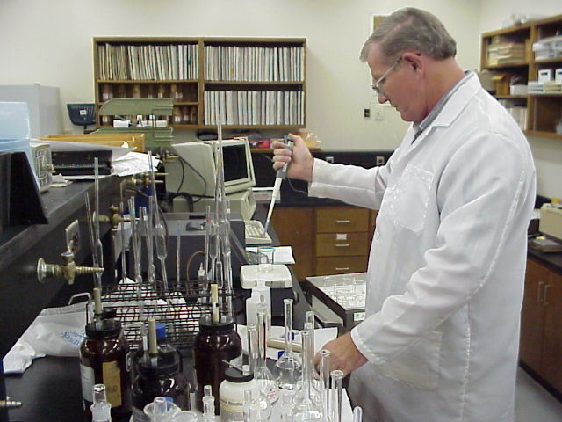
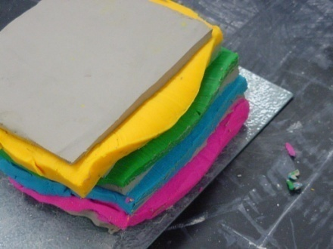
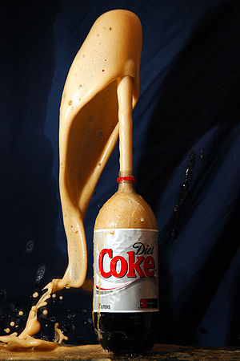
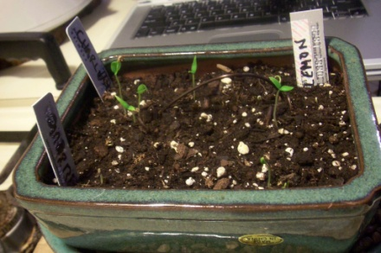
Interactions
Typical chemist---------
------Play-doh being smashed together
Mentos and coke geyser-----
----a dirt mixture

Slide 7
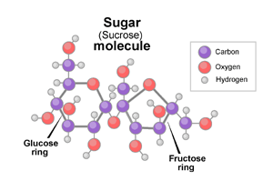
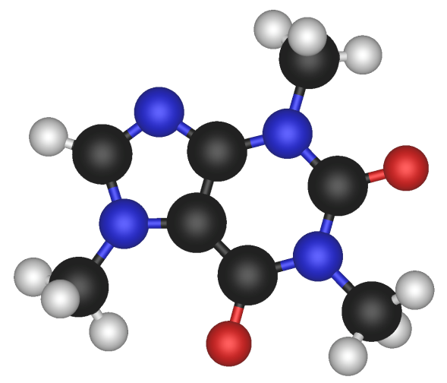
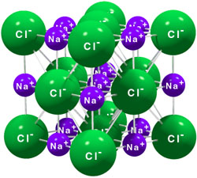
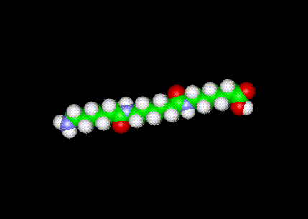
Arrangements of Atoms
Caffeine--------
Nylon-------
--------table salt

Slide 8
Parts of the Atom
An atom is very small, way too small to be seen without aid from microscopes. So small in fact that there are over 10²⁷ atoms in your body. Expanded out, that number is 1000000000000000000000000000 atoms!
An atom is made up of three parts:
Protons
Neutrons
Electrons
Protons and neutrons are both the same size and very large when compared to the electron (over 1000 times bigger)
The protons and neutrons are lumped together to form one unit called the nucleus
The electrons orbit the nucleus in specific patterns called orbitals

Slide 9
Parts of the Atom
Protons are positively charged. (+)
Electrons are negatively charged. (-)
Neutrons have no charge.
The charges on the proton and electron are equal in strength, even though the proton is much bigger than the electron.
A neutron carries no charge on it, but supplies “glue” to hold the nucleus together.

Slide 10
Parts of the Atom
A neutron is “neutral” and carries no charge.
The positive charge on the proton is equal strength to the charge of the electron, even though the proton is bigger.

Slide 11
Parts of the Atom
Scientific research has shown that atoms are made up of even smaller particles which we call quarks.
There a six types or “flavors” of quarks: up, down, top, bottom, strange, and charm.
Specifically, Up and Down quarks combine to form Protons and Neutrons

Slide 12
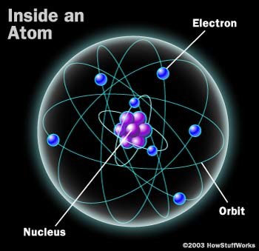
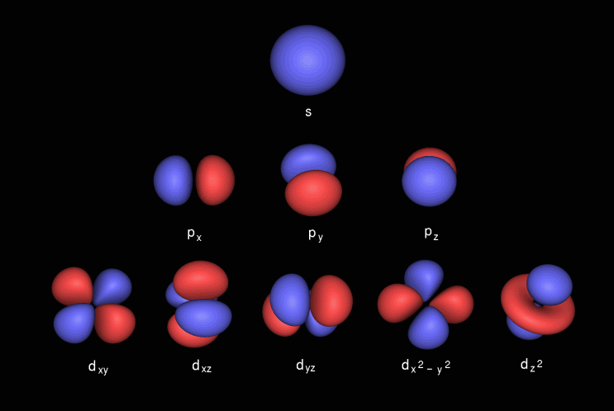
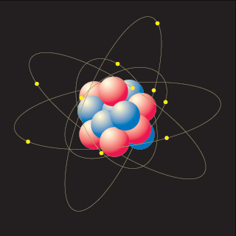
Atom Structure
What electron orbitals really look like----------
Notice size difference of electrons vs. protons and neutrons, in real life this is even greater!!

Slide 13
Periodic Table
The periodic table shows all of the types of atoms.
These elements (a type of atom, eg. Carbon) combine together in different ways to form the molecules of the compounds we see all around us.
For instance, one Oxygen atom (O) and two hydrogen atoms (H) make up the compound most commonly known as water. This can be written as H₂0

Slide 14
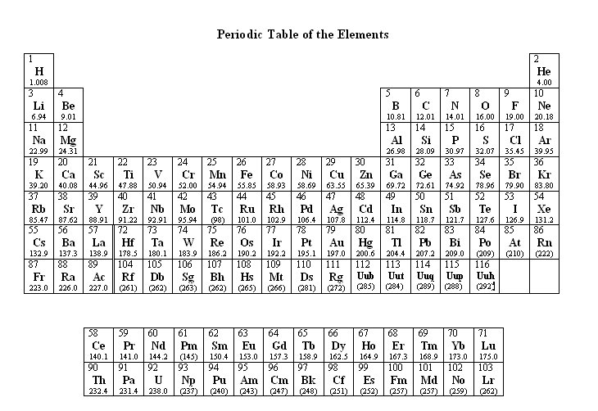
Periodic Table
This is a table of all the elements that can be formed by humans and nature:

Slide 15
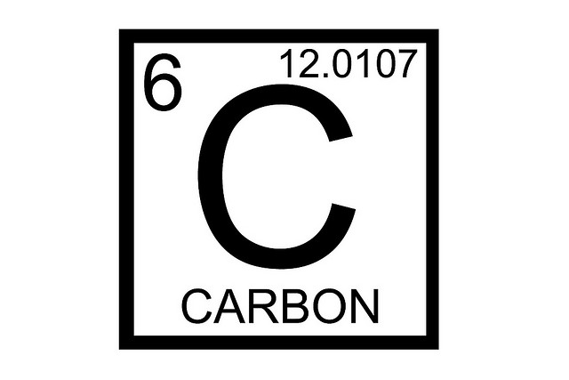
A Typical Element from the Periodic Table
The Atomic mass corresponds to number of protons and neutrons. (this element has 12 protons and neutrons, round to find this number)
The Atomic number corresponds to number of protons and determines element.
Atomic symbol
Name

Slide 16
Isotopes
An element can have different numbers of neutrons, while keeping the same number of protons. When this happens it is called an isotope.
Different isotopes have different nuclear properties, but have the same chemical properties as the regular element. The mass number lets you calculate how many neutrons an atom has
Example: ²³⁵U and ²³⁸U
They are still the same element, however ²³⁵U has 143 neutrons while ²³⁸U has 146 neutrons

Slide 17
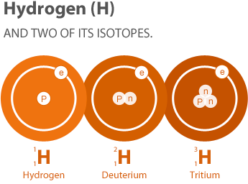
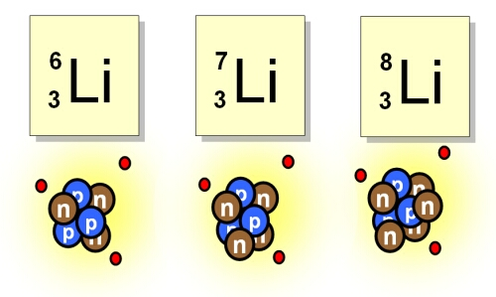
Isotopes
Hydrogen and lithium isotopes.
Notice the number of protons does not change, but the number of neutrons does. The isotopes will react chemically the same but their nuclear properties are different.

Slide 18
Chemical Reactions
As said before, atoms interact with one another. They form larger structures called molecules, crystals, and compounds.
When these larger structures interact, they can occasionally form new compounds. When the change occurs it is called a chemical reaction.

Slide 19
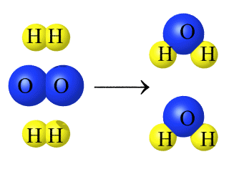
Chemical Reactions
Before Reaction
After Reaction
Hydrogen molecules
Water molecules
Oxygen molecule
This reaction is the burning of hydrogen gas

Slide 20
Chemical Reactions
Chemical reactions are important to us since they can cause a change in forms of energy quite readily.
Think of the gas in your car. Energy is stored in the gasoline molecules and when it is burned in your engine, chemical energy is converted into mechanical energy to make the car run.
It can also go the other way. Think of ICYHOT. The cooling sensation you get is from a chemical reaction sucking the heat energy out of the surrounding air, and your sore muscle.

Slide 21
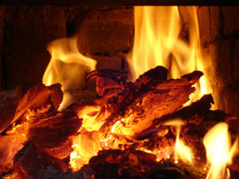
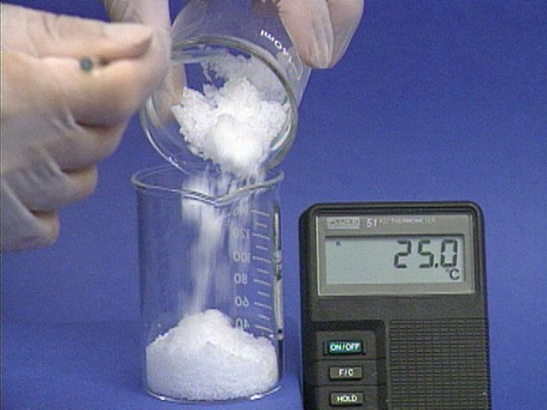
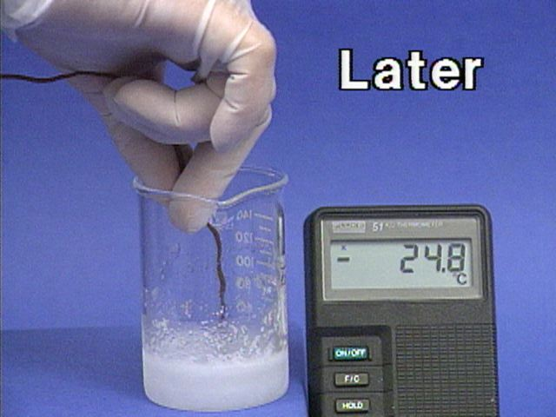
Chemical Reactions
As you can see this reaction is sucking energy into the substance, lowering the temperature. Not by a whole lot, but typically these reactions are hard to make happen.
This reaction we all know. By burning the logs energy is released into area, warming the air and your wet socks.

Slide 22
Why Nuclear Science is Different
While chemistry concerns the interactions between atoms, nuclear science concerns the interactions between parts of atoms.
This is very exciting!
Nuclear reactions can cause atoms to change elements, emit high energy waves, shoot off parts of their nucleus, and even explode.

Slide 23
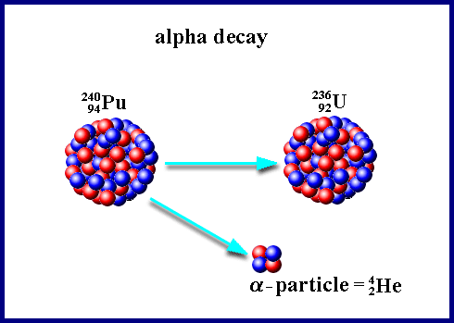
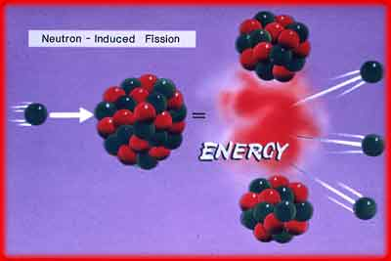
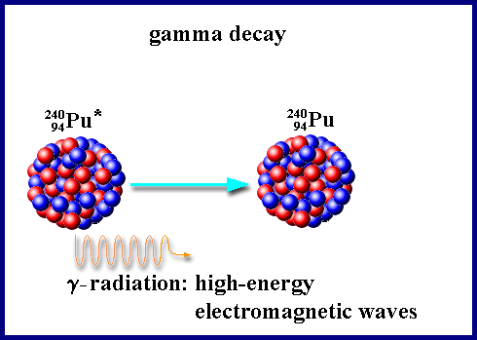
Examples of Nuclear Reactions
You can see this atom threw off some of its nucleus. Since some protons left, it changed elements as well.
This atom was too energetic (the * next to its symbol stands for that) and so it lost energy by shooting off a very high energy wave
Even atoms can explode! An amazing discovery, this is how nuclear power plants produce their power.

Slide 24
Why Nuclear Science is Different
While nuclear reactions are sometimes harder to see than chemical reactions, we still encounter them. Every time you go outside and feel the sun’s warming rays you are feeling the product of a nuclear reaction. Stars, like our sun, produce their light and heat by nuclear reactions. There are other sources of radiation that we come in contact with every day, but we can’t see the reactions. Here are some common naturally radioactive objects:
Bananas
Lantern mantles
Natural gas
Some smoke detectors

Slide 25
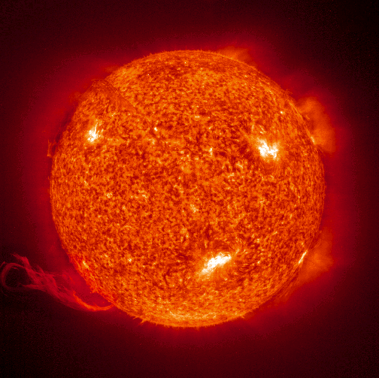
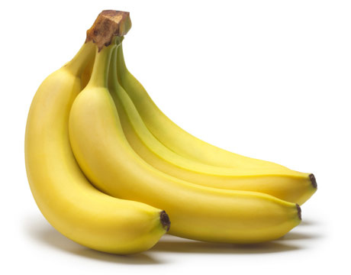
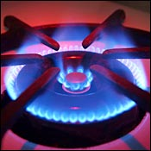
The sun is a giant fusion reactor, producing lots of energy to warm all of its planets
Bananas are great for you. They contain large amounts of potassium, which has a naturally radioactive isotope. (⁴⁰K)
Natural gas has radon in it, a naturally occurring, radioactive gas
Lantern mantles are produced with thorium, a radioactive heavy metal

Slide 26
Nuclear Science
When looking at changes in the nucleus of an atom you must consider that there are many things that can happen. We will review a few of these changes that are important to nuclear science.

Slide 27
Radioactive Decay
The most common nuclear reaction is radioactive decay. That is when a nucleus has too much energy and expends this excess energy in either the form of a particle or wave.
Particle decay releases part of the nucleus in the form of various sub-atomic particles.
Gamma decay does not release any material but releases energy in a form very similar to that of a light wave.

Slide 28
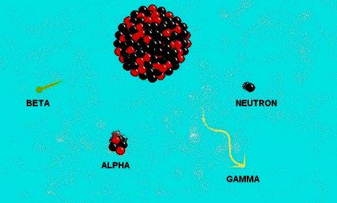
Radioactive Decay
This image shows the four most common types of decay. No atom will decay emitting all of these particles at once. But one atom could decay each of these ways emitting each particle one at a time. Out of all of these the gamma ray is the only one with out mass.

Slide 29
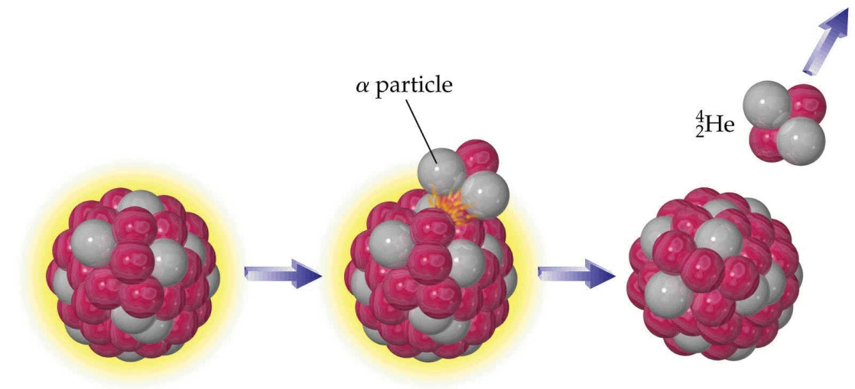
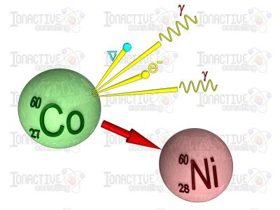
Radioactive Decay
Particle decay
waves
Particles
This is a wave decay, but you can see particles are also coming off, this is very common
Notice in both of these decays the element changed. Most nuclear decays change the element. This makes an engineering challenge. Imagine every time you turned around your workbench was a different material.

Slide 30
Particle Decay
There are several types of particles that can be released:
Alpha particles- a positively charged helium nucleus
Beta Particle- an electron formed in the nucleus of an atom
Neutron- a neutron that is expelled from the nucleus
Positron- a form of antimatter, same weight as an electron, but carries a positive charge
Neutrino- as close to nothing as you can get, of no real consequence to us as it doesn’t interact with anything really

Slide 31
Particle Decay
When these particles decay they are able to then interact independently with their surroundings and cause different things to happen.
Examples:
An alpha particle will smash through whatever material is there (imagine a bowling ball through the pins) and will pick up electrons to become a helium atom
A neutron may be born in a reactor where it can cause a fission event (don’t worry we’ll get to fission soon enough)
A beta particle may get picked up by an atom and become an orbital electron
A positron will annihilate an electron producing pure energy

Slide 32
Gamma Decay
When gamma decay occurs, energy will be released from the nuclear in the form of a gamma ray. A gamma ray is defined as a wave that is emitted from the nucleus of an atom. This wave will be very high energy and will interact in one of three ways.
It will be absorbed by an electron, which then energized will be ejected from orbit at an amazing speed.
It can give only some of its energy to an electron, still knocking it out, however the ray will continue on.
The last interaction that commonly occurs is called pair production. It occurs when a high energy gamma ray interacts in the vicinity of a nucleus and is converted to a positron-electron pair.

Slide 33
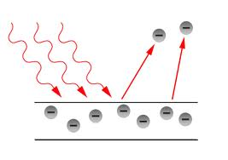
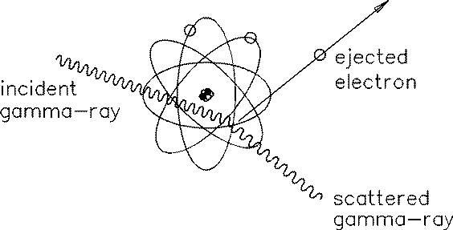
Types of Gamma Ray Interactions
This is when a gamma ray is completely absorbed by an electron. This is known as the photoelectric effect and is what Einstein received his Nobel prize for.
This is a gamma partially giving its energy away to an electron. Known as Compton scattering this scattering can be used to determine how wide the atoms are spaced in a crystal.

Slide 34
Nuclear Fission
Now that we have covered radioactive decay lets cover another important nuclear transformation, fission.
Fission occurs when the nucleus of an atom splits in two.
This is the process utilized to run nuclear reactors and produce power.

Slide 35
Nuclear Fission
The energy released in this reaction is what nuclear plants use to generate their power.

Slide 36
Nuclear Fission
Fission can only occur with certain very large atoms, such as uranium. These atoms are unstable enough to be able to be split. Smaller atoms are too well kept together by the strong nuclear force to be split.
The fission process is triggered when the nucleus of one of these certain atoms absorbs a neutron. When the nucleus absorbs this neutron it will become unstable, and then tear itself into two.
When this happens, several things are emitted.

Slide 37
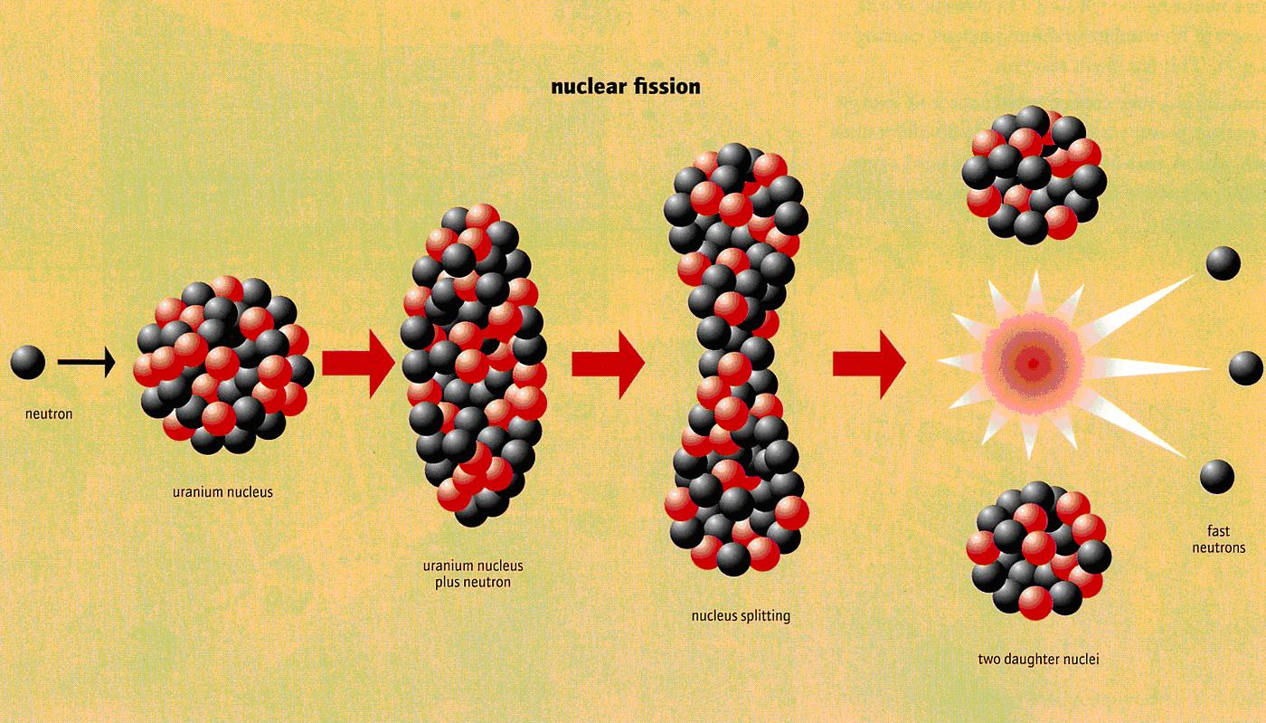
Fission Process
The nucleus actually morphs like this after it absorbs a neutron. It forms a lot of ovals, but as soon as the dumbbell shape is formed, it tears itself in two, releasing energy and more neutrons.

Slide 38
Fission Products
The things emitted are called fission products. First there are two new atoms that are emitted, these are the two big chunks of nucleus that was torn apart. There are also extra neutrons that are released in this process.

Slide 39
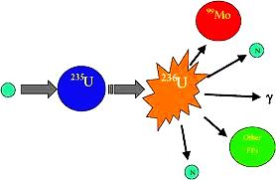
Fission Product Examples
This is an example of two fission products that can form as the result of a neutron hitting a 235U nucleus. Notice that it is briefly 236U before it fissions, since it has another neutron. Other things than just neutrons and fission products come out. This process is quite destructive and random. In short, there is a chance that anything particle-wise can come out of a fission event.

Slide 40
Chain Reaction
So, if a neutron is needed to fission a nucleus, and neutrons are emitted in a fission event, why don’t we use the neutrons from the event to cause another fission?
We do, this is called a chain reaction. Chain reactions are used in nuclear reactors to keep the fission events happening, this keeps the energy flowing and allows us to harness this for power production.

Slide 41
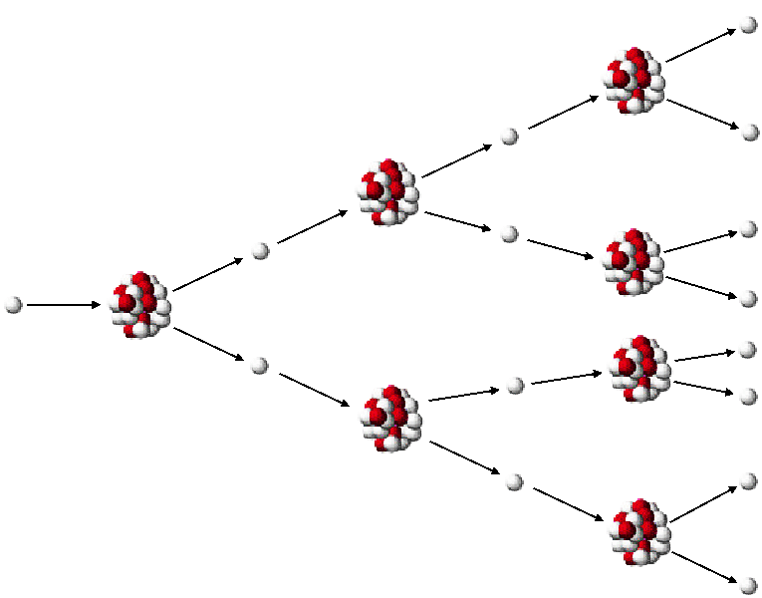
Chain Reaction
This is a basic illustration of a chain reaction. Using chain reactions we can keep the fuel “burning” in a reactor without having to provide neutrons ourselves. This reaction is “supercritical” meaning that it is growing in size. You can see each time there are more and more neutrons. In a power producing reactor, the number of neutrons is controlled so there is always the same number being absorbed and produced.

Slide 42
Conclusion
Thank you for taking the time to go through this course. While it is not required, doing extra research on your own before you come is highly encouraged.
www.NuclearConnect.org
If you are looking for information online here are some topics to look at:
Types of nuclear reactors
How nuclear science is used outside of power production
Fission
Consequences of radiation exposure
The history of nuclear power (Enrico Fermi, Albert Einstein)
Chart of the Nuclides
Pair production

