Slide 1
Guidance for the Presentation
Your presentation should last no more than 20 minutes. It is meant to be a high level overview of the health of your Division.
Have it reviewed by a fellow officer or the PDC Chair prior to submittal.
Avoid detailed explanations unless requested by a Board Member.
If there is a specific activity or highlight that is experimental or for which lessons learned were generated, do include.
The presentation can be archived on your Division’s website after presentation to the Board.

Slide 2
Division/TG
Presentation to the
ANS Board of Directors
Presenter
Date and Place

Slide 3
Division/TG Mission

Slide 4
Division/TG Leadership
Officers/Executive Committee
Current Officers (mark Young Members with ^{YM})
BOD Liaison
Standards Liaison
Other key personnel

Slide 5
Division Membership Trend

Slide 6
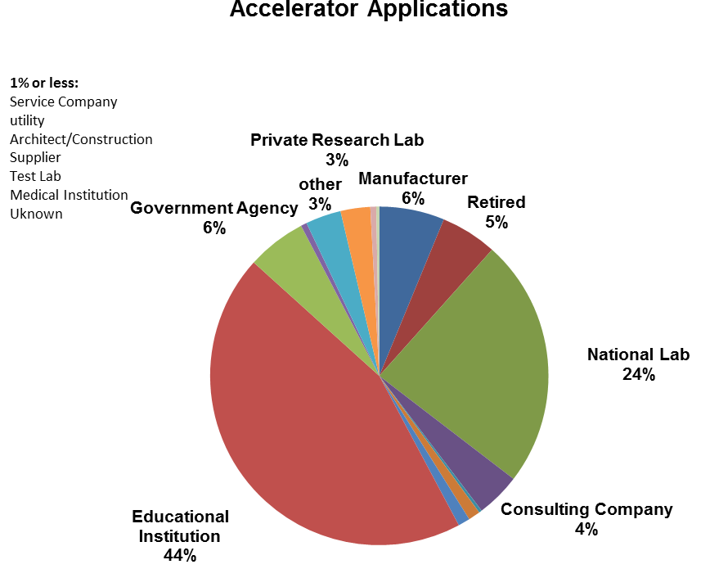
Demographics

Slide 7
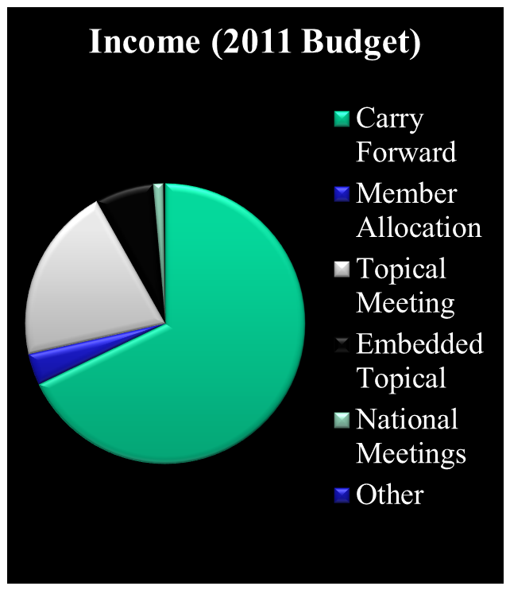
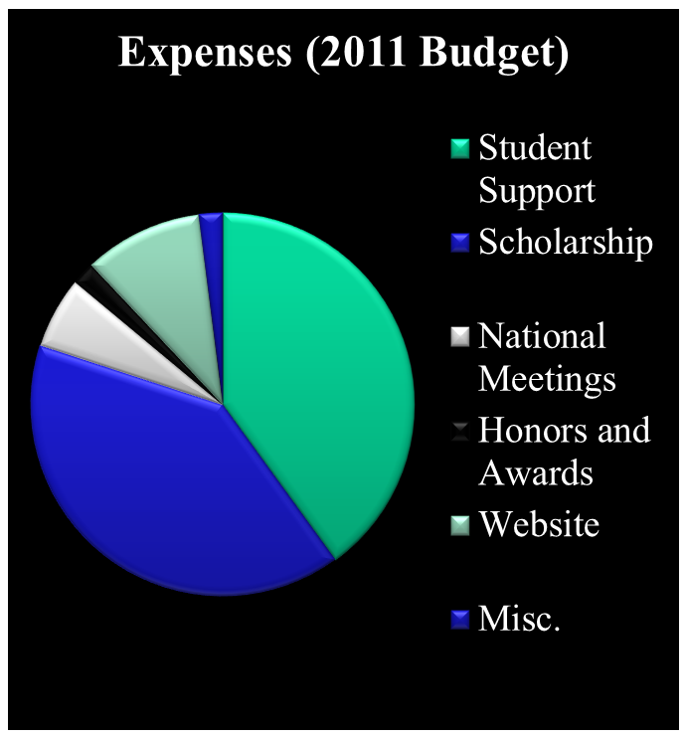
Expenditures/Revenues

Slide 8
Technical Meetings
 | Last Year | This Year
Name of Topical | WM 2017
Class/Co-sponsor | I
# of half-day sessions | 21
Registration (Planned/Actual) | 515/506
Net revenue (Planned/Actual) | $35K/$38K
 | Last Year | This Year
Sessions Sponsored at National Meetings*
* Does not include Embedded Topical, Co-sponsored sessions count as half

Slide 9
Contributions to Society*
Standards
List those currently under review by the Division (get from the Liaison)
Policy and Position Statements
List those currently under review
Affiliations with other technical organizations*
Students and Young Members
Communication
Website – url and date last updated (cite url)
Non-technical publications (frequency & type)
* This is meant to be a brief, high level listing not an exhaustive expose of Division activities in this area. The speaker can choose 1 or 2 on which to elaborate.

Slide 10
Performance against Goals
2017-2018 Goal* | Status
Goal | Not yet achieved
Goal | Met
Goal | Exceeded
2018-2019 Goal
Goal
Goal
Goal
Typical Goal categories: Meetings/Membership/Service to Society/
Governance/Finance/Communication
* Aligned with Society Strategic Plan?

Slide 11
Summary
Statement of Overall Division Health
Focus of Future Action(s)/Direction

