Slide 1
American Nuclear Society
Mathematics and Computation Division
Presentation to the
ANS Board of Directors
Patrick S. Brantley, Chair
November 9, 2016 – Las Vegas, NV

Slide 2
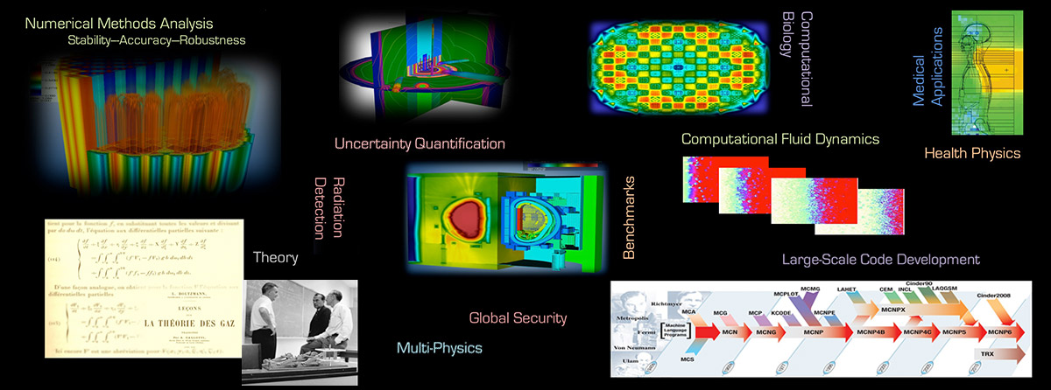
MCD Mission Statement
The Mathematics and Computation Division (MCD) promotes the advancement of mathematical and computational methods for solving problems which are of interest to all disciplines encompassed by the American Nuclear Society (ANS) and of benefit to the application of nuclear science and engineering.
MCD specific areas of focus include mathematical and computational methods, numerical analysis, computer codes, computer architectures, and benchmarks.

Slide 3
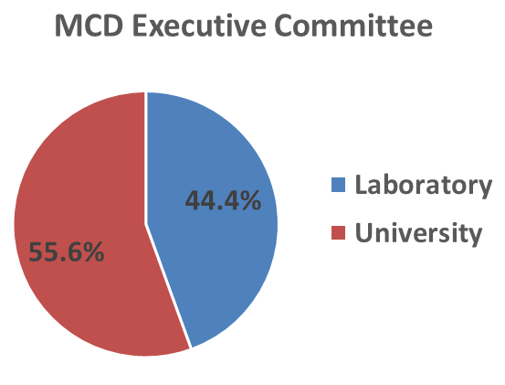
MCD Governance Structure
Chair, Vice-Chair – 1 year terms
Secretary, Treasurer – 2 year terms
Executive Committee – 3 year terms
Executive committee generally a mix of laboratory and university representatives, with small industry contributions at times

Slide 4
MCD Governance (2016-2017)
Executive Committee
Erin Fichtl (LANL), Benoit Forget (MIT), Barry Ganapol (Univ. of Ariz.), Steven Hamilton (ORNL), Brian Kiedrowski (Univ. of Mich.), Richard Martineau (INL), Ryan McClarren (Texas A&M Univ.), Tara Pandya (ORNL), Jean Ragusa (Texas A&M Univ.)
Ex Officio
Tunc Aldemir (OSU), Hans Gougar (INL)
Board Liaison
Sandra Dulla (Polit. di Torino)
Staff Liaison
Valerie Vasilievas (ANS)
Officers
Patrick Brantley (LLNL) – Chair
Rachel Slaybaugh (U.C. Berkeley) – Vice-Chair
Wei Ji (RPI) – Secretary
Aaron Watson (KAPL) – Treasurer

Slide 5
MCD Governance
Bylaws & Rules Status
  Bylaws and Rules last updated in July 2013
Communication:
  MCD website (http://mcd.ans.org/) – updated 2015, opportunity exists for improvement
  Incorporated ANS Collaborate into division communication
  Developed Divisional Roles and Responsibilities document to assist with leadership succession
  Reinvigorating MCD newsletter is an area of current emphasis

Slide 6
MCD Governance
Strategic Planning Status
  Update of MCD Strategic and Tactical Plan is currently underway
MCD efforts support ANS Strategic Plan
    Mission Component 1 – Professional Development
      Maintain highest technical standards for quality in ANS Transactions and in premier biennial Mathematics & Computation topical meeting
      Organize code workshops and special sessions at meetings
      Peer recognition awards including Best Paper + Presentation Award
    Mission Component 2 – Sharing Information and Advancements in Technology
      Significant member interaction with international science community and professional societies
      Strong technical program at national and topical meetings
      Engagement in ANS Standards related to software use and development
      Members publish in ANS journals
    Mission Component 3 – Engaging the Public
      Promote careers in nuclear science and technology through student involvement and education
      Development of MCD website
      MCD members have authored and contributed to open source software
    Mission Component 4 – Engaging the Policy Makers
      MCD not typically involved with policy makers

Slide 7
MCD Membership Trend
~10% of ANS
~20% students

Slide 8
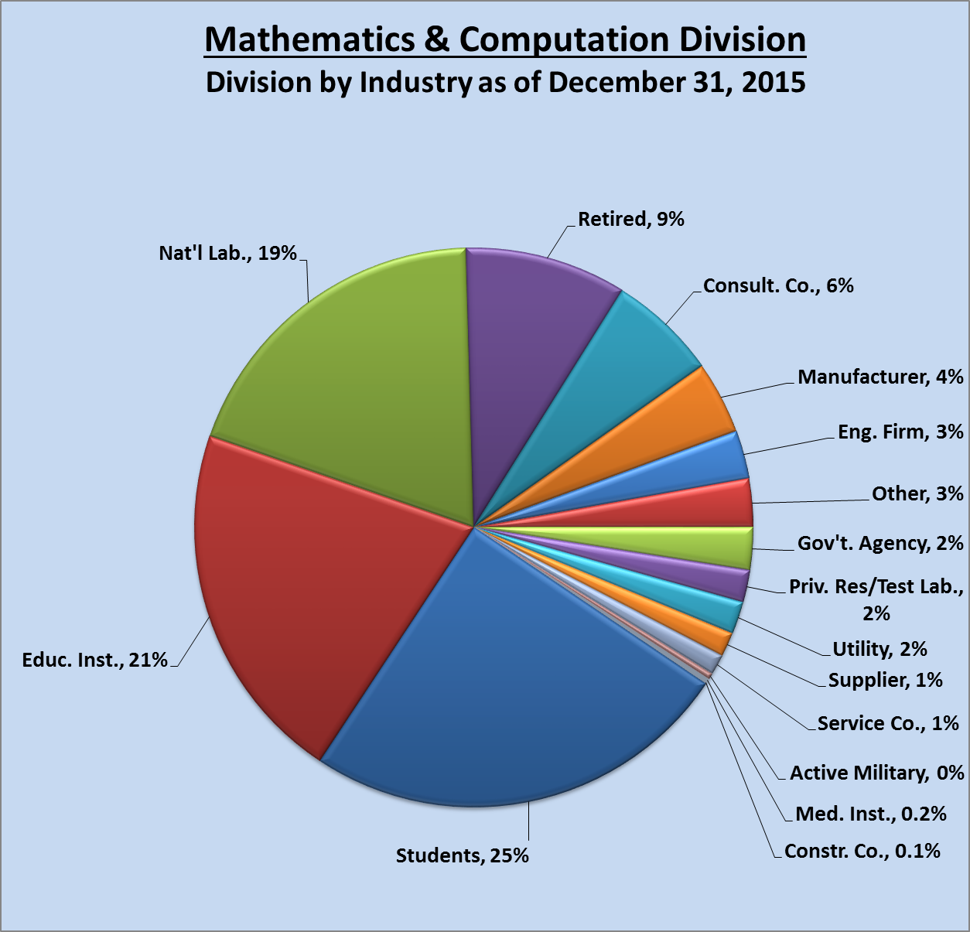
MCD Membership by Group

Slide 9
MCD Finances
MCD DIVISION FINANCES | BUDGET | ACTUAL
 | 12 MONTHS | 9 MONTHS
 | 2016 | 2016
BUDGET FUNDS
CARRY FORWARD FROM 2015 | 45,652 | 45,652
2016 MEMBER ALLOCATION | 2,138 | 1,708
DIVISION INCOME 2016 | 0 | 0
TOTAL BUDGET FUNDS | 47,790 | 47,360
BUDGET EXPENSES
AWARDS, PLAQUES | 1,500 | 55
NATIONAL MEETING COSTS | 1,500 | 0
STUDENT SUPPORT | 3,500 | 3,500
SCHOLARSHIP & NEED FUNDING | 20,000 | 0
OTHER EXPENSES | 30 | 0
TOTAL EXPENSES | 26,530 | 3,555
EXCESS OF BUDGET FUNDS OVER EXPENSES | 21,260 | 43,805

Slide 10
MCD Contributions to Society
Society Leadership
  Our members serve on the ANS board and actively participate in standing committees
Standards
  MCD members engage in standards through ANS-10 Mathematics and Computation subcommittee
Position Statements
  MCD members, especially the members of the executive committee, standing committees, and officers have individually contributed to ANS position statements
  MCD maintains no position statements
Affiliations with other technical organizations
  Our members participate in SIAM, AAPM, ASTM, APS, and AAAS societies
  Co-sponsorship of meetings, e.g., Supercomputing in Nuclear Applications + Monte Carlo (SNA+MC)

Slide 11
MCD Contributions to Society
Endowed Scholarships
  Robert A. Dannels Memorial Graduate Scholarship ($3,500/year)
  Ely M. Gelbard Memorial Graduate Scholarship – actively raising funds for endowment (planned $3,500/year)
Professional Development
  Our members organize code workshops at national and topical meetings
  MCD sponsors Roundtable on “Current Issues in Computational Methods” at national meetings
Peer Recognition/Awards
  Gerald C. Pomraning Memorial Award
  Distinguished Service Award
  Young Member’s Research Achievement Award
Non-Meeting Publications
  Our members publish papers in Nuclear Science and Engineering, Nuclear Technology, Annals of Nuclear Energy, Progress in Nuclear Energy, Journal of Computational Physics, Journal of Medical Physics, JCTT, SIAM Journals, IEEE Journals, ASTM Journals

Slide 12
Summary
Areas of Success
  Strong technical program at national ANS meetings (typically ~5-7 sessions + co-sponsor with RPD), including establishment of regular Uncertainty Quantification and Sensitivity Analysis session
    MCD national meeting attendance averages approximately 150, 25% students
  Biennial M&C Topical Meetings (typically Class I) very successful – include significant U.S. and international involvement
    M&C 2017 – Jeju, Korea
  Ely M. Gelbard Memorial Graduate Scholarship endowment actively proceeding
  Best Paper + Presentation award at ANS national meetings
  Increasing trends in number of members
  Significant student participation – ~20% of membership
    Sponsor and participate in ANS Student meetings
  Effective collaborations with international nuclear community
  Organization of code workshops at national and international meetings

Slide 13
Summary
Focus Areas for Future Action
  Continue working to understand how to attract and engage young members
  Continue our efforts in organization of quality national and topical meetings
  Further develop new technical areas in which MCD members participate - e.g. multiphysics, computational materials
  Reestablish leadership in computational benchmarks
  Complete Strategic and Tactical Planning Process
  Reinvigorate MCD newsletters

