Slide 1
American Nuclear Society Nuclear Installations Safety Division
Agenda Item #4.b
Presentation to the
ANS Board of Directors
Ronald A. Knief, Chair
Susan Y. Pickering, Vice-Chair
June 10, 2015
San Antonio, Texas

Slide 2
NISD Mission
Devoted specifically to the safety of nuclear installations and the health and safety of the public, this division seeks a better understanding of the role of safety in the design, construction and operation of nuclear installation facilities. The division also promotes engineering and scientific technology advancement associated with the safety of such facilities.

Slide 3
NISD Governance
Officers (2015-16)
Susan Pickering, Chair
Martin Sattison, Vice Chair/Chair Elect
Robert Martin, Secretary/Treasurer (Extended term)
Ronald Knief, Immediate Past Chair
Executive Committee: 10 additional members, 3-year terms, 1 resignation
Committee Chairs
Program: Edward Blandford
Honors & Awards: Phil Ellison
Newsletter: Eric Harvey
Social Media: Matt Denman
Nominations: Ronald Knief
Board Liaison
Jorge Spitalnik

Slide 4
NISD Governance
Bylaws & Rules Status
Standard Bylaws for Divisions adopted 2007
Bylaws and Rules review and update 2012-2015.
Strategic Planning Status
Tactical Plan updated perpetually
Strategic Plan current version March 2012
Strategic Paln being updated 2014-2015
Communication
Website: http://nisd.ans.org/
Newsletter
Issued twice each year (Spring, Fall)
Available at website
Facebook:
http://www.facebook.com/home.php?sfrm#!/groups/183330093171/

Slide 5
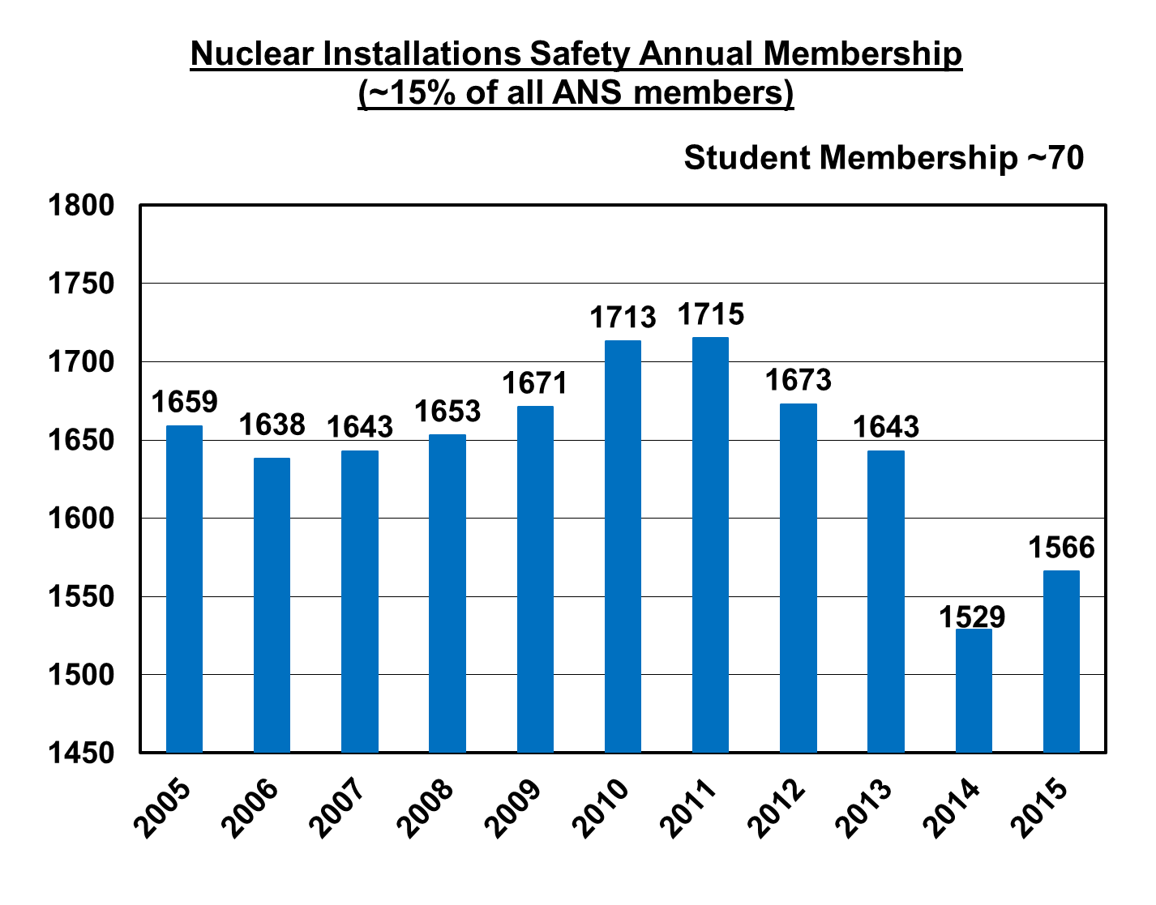
Division Membership Trend

Slide 6
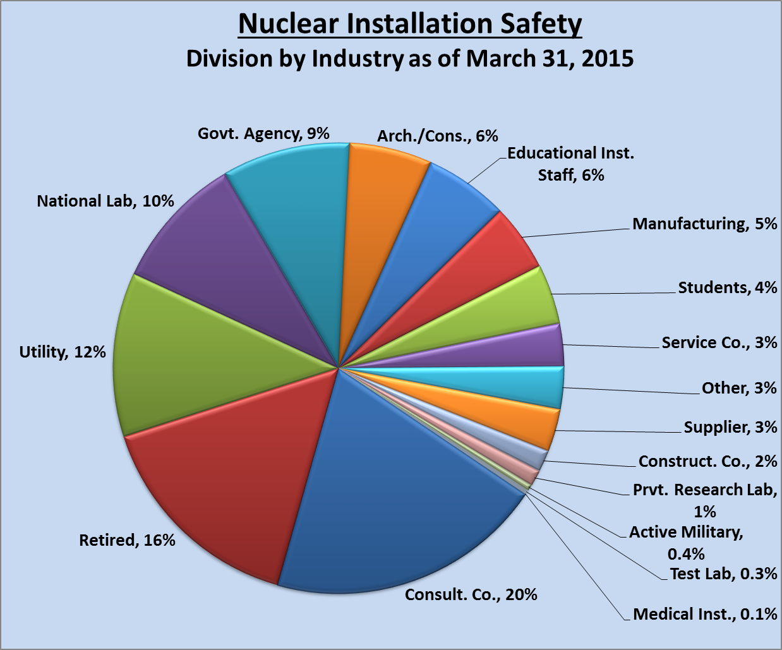
Division Membership

Slide 7
NISD Meetings
National Meeting Participation
Strong NISD Session Tracks at National Meetings
“Perpetual ~20” topics for consideration
Reno 2014 – 4 Sessions
Anaheim 2014 – 6 Sessions
San Antonio 2015 – 4 Sessions
Consistently exceed minimum paper count for large Division
Topicals
Class I
2013 PSA-13, Columbia, SC, September 22-26
2015 PSA-15, Sun Valley, Idaho, April 26-30
Very successful: Content; Attendance; Corporate /Organization Support
2016 Tritium 2016, Charleston, SC, April 2016 [Sponsored by FED; co-sponsored by NISD & DESD]
2017 PSA-17, Pittsburgh (tentative), August/September 2017

Slide 8
NISD Meetings
Topicals (continued)
Class III
2013 Risk Management for Complex Socio-Technical Systems (RM4CSS), Washington, DC, November 10-14
2017 Risk Management V in Washington, DC
Class IV
2013 PSAM – PSA and Risk Management after Fukushima, Tokyo Japan, April 15-17
2014 9th Nuclear Plants Current Issues, Charlotte, NC, December 7-11
Post-symposium seminar Seismic PRA: Post-Fukushima Implementations, December 11-12
2015 Safety-Security Risk-Informed Decision-Making Workshop [in concert with PSA-15 and INMM]
2015 10th Nuclear Plants Current Issues, Charlotte, NC, December 11-14
Supported ANS with paper for 6th International Conference on Nuclear Energy, Prague, Czech Republic, November 2013
Initiative for NISD Best Paper Award
Planning YMG special session for (THD model)

Slide 9
Division Finances
 | 2014 | 2015
Budget Funds | (actual) | (budget)
Carry forward from previous year | 40663 | 32779
Member Allocation | 1637 | 3200
Division Income | 0 | 10000
Total Budget Funds | 42300 | 45979
Expenses
Awards, Plaques | 55 | 2000
National Meeting Costs | 0 | 0
Student Support | 7200 | 5750
Newsletter | 0 | 0
Other Expenses (Endowment Support) | 2016 | 2023
Scholarship Funding | 250 | 250
Total Expenses | 9521 | 10023
Excess (Deficiency) | 32779 | 35956

Slide 10
Division Finances [Honors & Awards]
Two Annual Scholarships
Raymond DiSalvo Undergraduate Memorial Scholarship ($2000)
2014 Recipient: Travis Labossiere (University of Tennessee)
2015 Recipient: Travis Ty Willis (North Carolina State University)
Saul Levine Graduate Memorial Scholarship ($3000)
2014 Recipient: Derek Man Hon Hung (University of Michigan)
2015 Recipient: Nicolas Zweibaum (Univ. California-Berkeley)
Awards (may “double-up” in 2015)
Theos J. ("Tommy") Thompson Award For Reactor Safety
Most recent recipients: Bill Vesely (2012)
Ali Mosleh (2013)
George C. Laurence Pioneering Award
Most recent recipient: Adolf Birkhofer (2013)
Related
Website Content
Special Session

Slide 11
Division Contributions to Society
ANS Position/Policy Statements
#24 Nuclear Facility Safety Standards
#46 Risk Informed & Performance Based Regulations for Nuclear Power Plants
#51 Reactor Safety
(Proposed) Emergency Planning Zones
Position papers active and assigned for review in 2015
Participation with Other Professional Societies
Active participation with EFCOG, IEEE, NHA, ASME, NEI, INMM
Society Leadership
Division Past Chair co-chaired President’s Special Committee on SMRs
Division Past Chair co-chaired Special Committee on Fukushima and was ANS President 2012-13
NISD members serve on broad cross-section of national committees
Several NISD members serve on the Standards Board
Full participation in PDC meetings and workshops

Slide 12
Division Contributions to Society
Non-Meeting Publications
ANS Std-10.4 WG
RISC Committee (NISD member served as chair)
ANS Fire PSA
Numerous standards, including ANS 50.1, 53.1, 54.1, 58.22; ANS/ASME 58.24, 58.25; NCSCC & 8.20
Liaisons
YMG
THD
Nuclear Production of Hydrogen WG
Codes & Standards – Emphasis on Risk-Informed
ANS “History”
75th anniversary of fission
Ted Rockwell memorial

Slide 13
Summary
Areas of Success
Increased use of social media
Strong student support – national meetings and student conferences
Attracting “new blood” to NISD activities
Three new EC members targeted by “industry”
New Program Committee members
New Newsletter editor
Strong commitment to young member participation and liaison with YMG
Program Committee – Including current and past chairs
Newsletter/website editor
Successful Division topical meetings and strong national meeting participation

Slide 14
Summary
Focus for Future Action
Continue to encourage student and young membership in Division and its governance and other activities
Look for new topics for workshops/tutorials
Consider establishment of new scholarships
Expand collaboration with international societies
Support post-Fukushima ANS outreach
Continue to be the focal point for technical exchange and public information in the area of nuclear installation safety

